Slide 1
Physics 4 – Mar 13, 2020
P3 Challenge – Given the following masses:
U-235 = 3.9029 x 10⁻²⁵ kg,
n = 1.6749 x 10⁻²⁷ kg,
La-142= 2.3563 x 10⁻²⁵ kg,
Br-91 = 1.5097 x 10⁻²⁵ kg
Determine the energy produced in the fission reaction below:

Slide 2
Objectives/Agenda/Assignment
Objective:
7.2 Nuclear Applications
Assignment:
Agenda:
Radiation Units
Measuring Radiation
Nuclear reactions (fission/fusion)

Slide 3
Units of Radiation
SI Metric unit for counting radioactivity is the Curie (Symbol: Ci)
1 Curie = 3.70 x 10¹⁰ d/s (disintegrations per second)
1 Becquerel = 1 d/s
Radiation is also measured in terms of its effects on tissue.
The rem is the unit of radiation dosage equivalent to a given amount of tissue damage in a human.
Takes into account the different effects on tissue (alpha most destructive)
The mrem (millirem) is by far the most commonly used radiation unit.
May also see Sievert. 1 Sv = 100 mrem
1 Millisievert = 0.01 mrem

Slide 4
Radiation Dosage
Typical public dosage per year: 500 mrem (about 350 mrem from background environmental sources – cosmic rays, the sun, Radon in the atmosphere, isotopes in the ground, isotopes in brick/stone building materials + about 150 mrem from medical testing or plane trips or TV/Computer screens or power plants)
Limit for general public: 2,000 mrem
Limit for radiation workers: 5,000 mrem
Health effects: none below 25,000 mrem

Slide 7
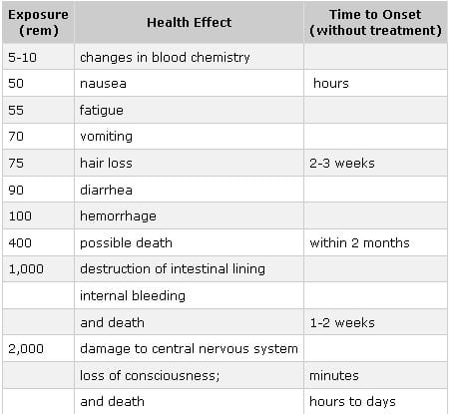

Slide 8
Measuring Radioactivity
Geiger Counter: An ionization counter detects radioactive emissions as they ionize a gas
Ionization produces free electrons and gaseous cations, which are attracted to electrodes and produce an electric current.

Slide 9
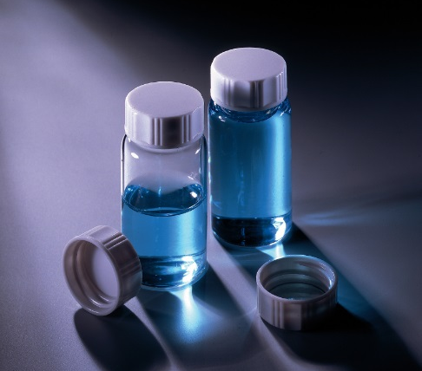
Measuring Radioactivity
Scintillation Counter: detects radioactive emissions by their ability to excite atoms and cause them to emit light.
Radioactive particles strike a light-emitting substance, which emits photons. The photons strike a cathode and produce an electric current.

Slide 10
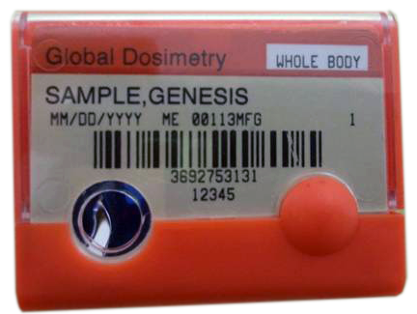
Measuring Radioactivity
Thermoluminescent dosimeter (TLD) badge.
Radiation workers are required to wear this kind of badge to monitor the number of mrems they are receiving.
When I was a radiation worker at Cornell, our badges served as our door key. If the badge were ever to go over the 5000 mrem limit, the door to the facility would simply not allow entry.

Slide 11
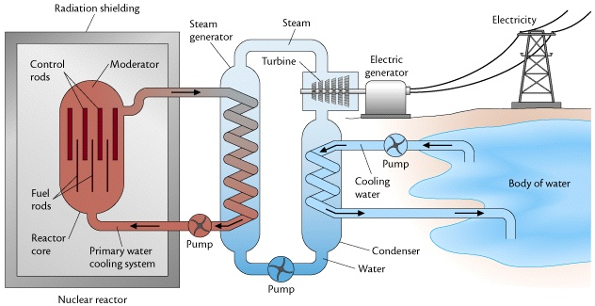
Nuclear Energy Reactors
Nuclear Energy Reactors operate near the critical mass and use control rods containing neutron “sponges” to slow the reaction as needed.
Control rods integrate into the fuel rods and can be lowered for more contact slowing the reaction or raised for less contact speeding the reaction.
This is usually monitored constantly by a computer.

Slide 12
Nuclear Energy Reactors
Parts:
Reactor Parts shielded in concrete containment structure.
Why the need to contain a reaction?
Provide sufficient shielding in the event of a run away nuclear reaction (nuclear meltdown)
Isolate nuclear reaction from earthquakes and other environmental disasters (E.g. Fukushima Tsunami)
Protect nuclear reaction from explosions elsewhere in the power plant (Not present on Chernobyl reactor – steam explosion released radiation)

Slide 13
Nuclear Energy Reactors
Parts:
Reactor Core
Fuel Rods (contain the uranium reaction materials) enriched to 3 % U-235 in a uranium oxide ore.
Control Rods of B or Cd (Neutron sponges, stops neutrons by reacting with them)
E.g. ¹⁰B + n → [¹¹B] * →  + ⁷Li
Moderator – usually heavy water (D₂O) (slows down the neutrons in elastic collisions)

Slide 14
Nuclear Energy Reactors
Parts:
Heat from the reactor
Sent to Electric generator via steam turbine (same generator system used by coal plants)
Sent to a nearby body of water to keep the reactor cool
The typical large white nuclear towers are cooling towers that release excess steam heat into the atmosphere.

Slide 15
Nuclear Plant Locations
The spot in the center of Missouri is Calloway.
1st built during WWII
By 2020,
97 in US in 30 states (we have more than any other country)
450 worldwide in 35 countries

Slide 16
Nuclear Waste
Nuclear waste has two characteristics: volume and radioactivity.
A sample may be small, but highly radioactive, or it may be large but relatively low radioactive.
Low level radioactive waste is placed in sealed containers and buried 20 feet deep in concrete lined trenches.
The low volume but highly radioactive spent fuel rods from nuclear power plants cannot be disposed this way. They are currently stored on site and there is no permanent long term waste disposal facility exists for this highly radioactive waste.
Yucca Mt, NV Proposed 1987, cancelled 2009 (under discussion)
Carlsbad, NM opened 1999 (under discussion)

Slide 17
Webquest activity
Complete the webquest questions using the websites provided to collect information to support your answer to the discussion question at the end.
20 pt activity.
Due on Tuesday after Spring Break.

Slide 18
Exam Description
11 Multiple Choice questions 2 pts ea for a total of 22 pts.
Atomic and nuclear structure, binding energy, units, H atom, fission, fusion, nuclear reactions, decay reactions, types of decay, light and atoms, emission/absorptions, photons….
3 short answer questions 4, 6 and 8 pts for a total of 18 pts.
photon and emission/absorption calcs, Rydberg formula, H atom…
5 x 12 pts ea problems
Using nuclide table, write decay reactions, calculate decay energy, calculate binding energy, calculate binding energy per nucleon, use decay rate equation, half-life determination, decay series identification…

Slide 19
Exit slip and homework
Exit Slip –
What’s due? (homework for a homework check next class)
8.1 p327 #7-11 and Webquest
Extra practice questions (Answers posted online over break)
Study for Nuclear Physics Unit Test Thursday after Spring Break
What’s next? (What to read to prepare for the next class)
Read 7.1, 7.2

